Slide 1
Inexorable Pull
Revelation 14-16
Notes:
“Inexorable” = “Unavoidable” = Gravity
=Reason 4 Proph: ~Jst Crazy Wrld→Inexorable
JC “Learn to read the signs…”

Slide 2
The Course of Humanity
2 Peter 1:19-21
So we have the prophetic word made more sure, to which you do well to pay attention as to a lamp shining in a dark place, until the day dawns and the morning star arises in your hearts.
But know this first of all, that no prophecy of Scripture is a matter of one's own interpretation,
for no prophecy was ever made by an act of human will, but men moved by the Holy Spirit spoke from God.

Slide 3
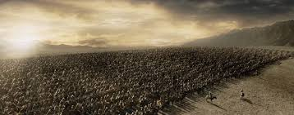
The Course of Humanity
Israel will be dispersed and regathered.
Ezekiel 37:11-12 Then he said to me, “Son of man, these bones represent the people of Israel. They are saying, ‘We have become old, dry bones—all hope is gone. Our nation is finished.’ Therefore, prophesy to them and say, ‘This is what the Sovereign LORD says: O my people, I will open your graves of exile and cause you to rise again. Then I will bring you back to the land of Israel.
Ezekiel 37:13 When this happens, O my people, you will know that I am the LORD.
Notes:
**37:13=STUNNING Proof! →Details: “Finished!”
Libs=Date Ezek. ’48 (Mt,etc.=70 ad)
(Daniel=180 bc) (Isaiah=2 C later)

Slide 4
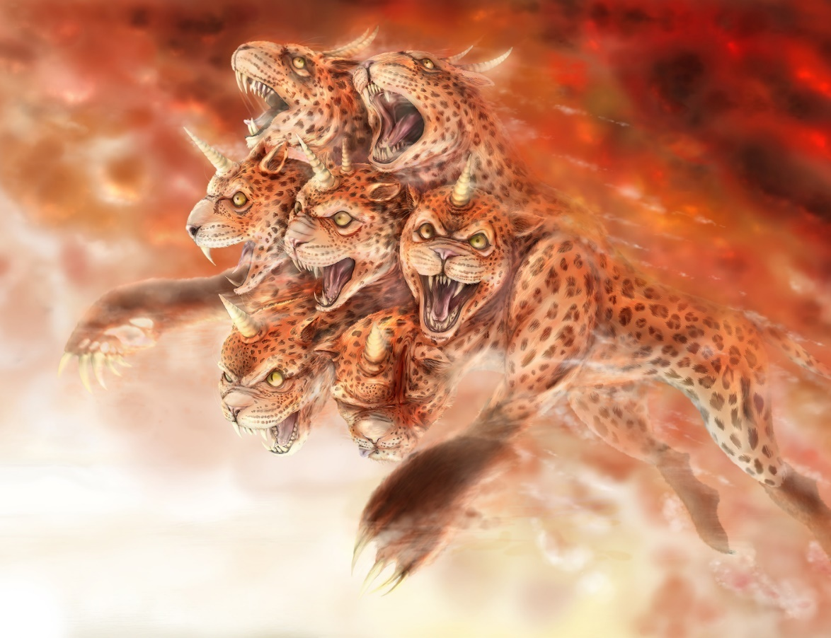
The Course of Humanity
Israel will be dispersed and regathered.
A 10-Nation European Union Arises. (Dan.2,8; Rev.13)
Revelation 13:1-2 Then I saw a beast rising up out of the sea. It had seven heads and ten horns, with ten crowns on its horns. And written on each head were names that blasphemed God. This beast looked like a leopard, but it had the feet of a bear and the mouth of a lion! And the dragon gave the beast his own power and throne and great authority.
NOT the 28-Nation E.U.

Slide 5
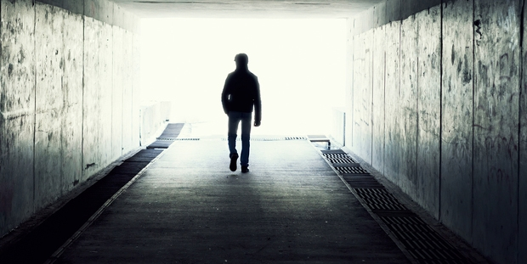
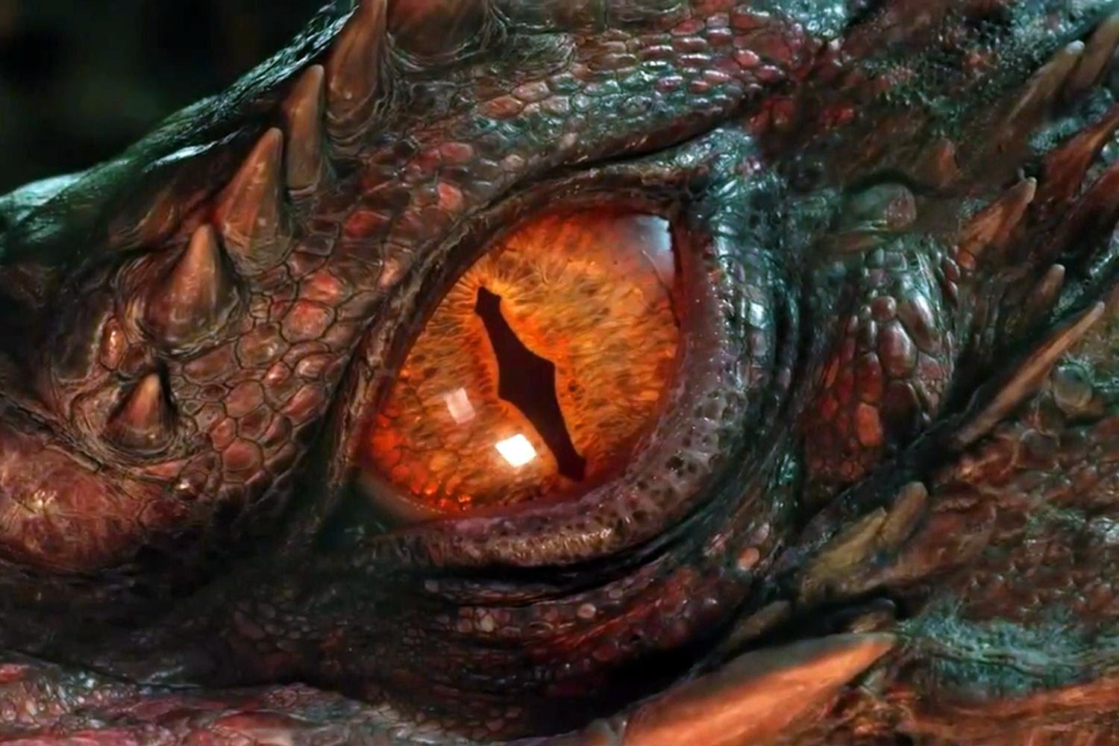
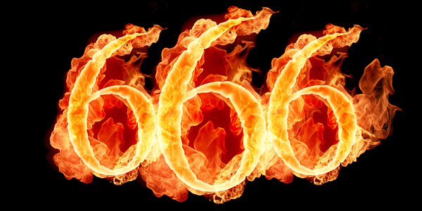
The Course of Humanity
Israel will be dispersed and regathered.
A 10-Nation European Union Arises. (Dan.2,8; Rev.13)
A world leader, 1-world economy & religion (Rev.13)

Slide 6
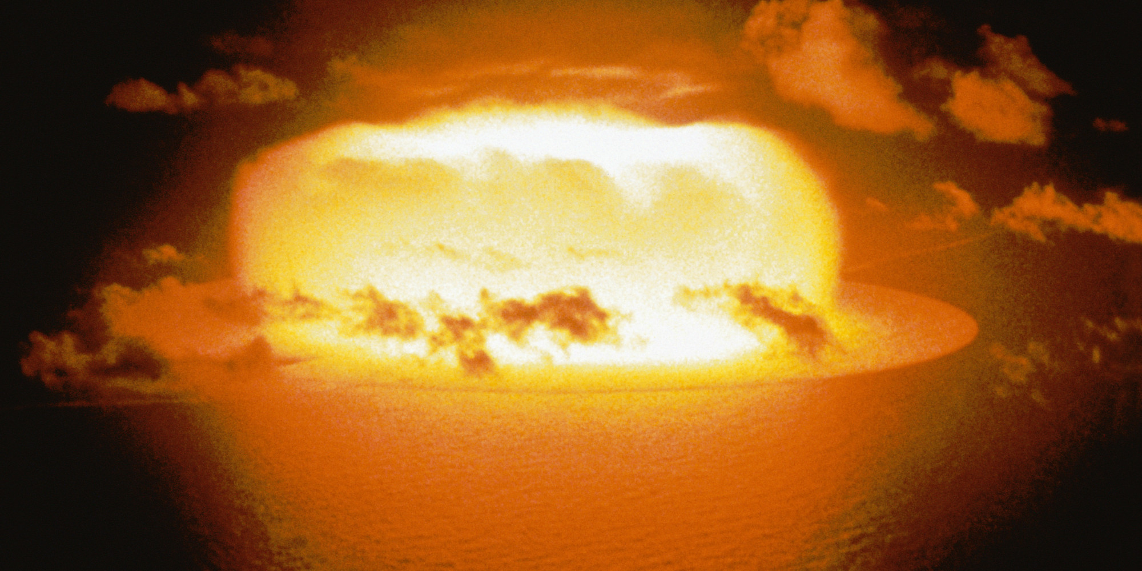
The Course of Humanity
Israel will be dispersed and regathered.
A 10-Nation European Union Arises. (Dan.2,8; Rev.13)
A world leader, 1-world economy & religion (Rev.13)
Armageddon (Rev.15-16)
Notes:
Armageddon= Russia → Europe → China

Slide 7
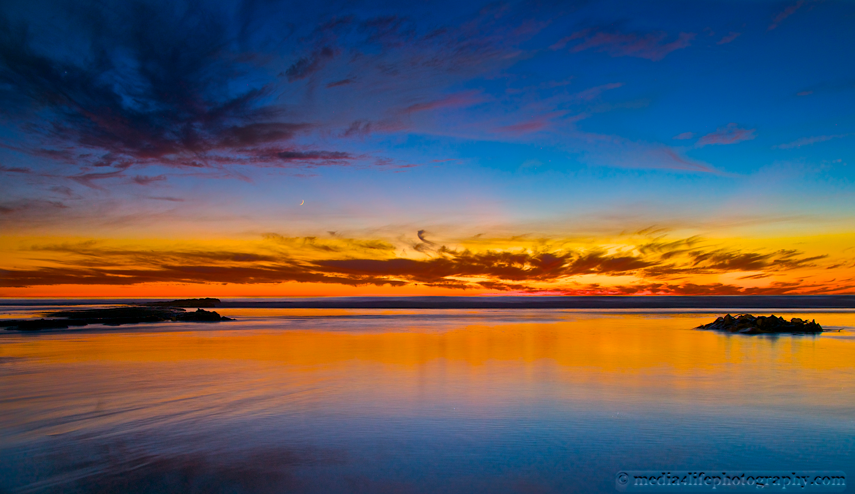
The Course of Humanity
Israel will be dispersed and regathered.
A 10-Nation European Union Arises. (Dan.2,8; Rev.13)
A world leader, 1-world economy & religion
Armageddon
God Intervenes (Rev.14-15)
Revelation 15:4 ”Who will not revere you, Lord, and glorify your name? For you alone are unique. All nations will come and worship before you, for your righteous deeds have been revealed.”
Revelation 15:3 And they were singing the song of Moses, the servant of God, and the song of the Lamb: “Great and marvelous are your works, O Lord God, the Almighty. Just and true are your ways, O King of the nations.
Revelation 15:2 I saw before me what seemed to be a glass sea mixed with fire. And on it stood all the people who had been victorious over the beast and his statue and the number representing his name. They were all holding harps that God had given them.
Notes:
15:2 = BEAUTIFUL!! → G-Instruments → ~Air Guitar!
** “..Just..King..” → JC Rules=RELIEF! Peace! Beauty!
Cleans up the planet → 1k Yrs → “Heaven”=Earth!
** “Revere..Unique” → NOTHING Like It →Even Imitations!

Slide 8
The Course of Humanity
Israel will be dispersed and regathered.
A 10-Nation European Union Arises. (Dan.2,8; Rev.13)
A world leader, 1-world economy & religion
Armageddon
God Intervenes (Rev.14-15)
Doesn’t Matter
Isaiah 13:6-8 Wail, for the day of the LORD is near! …all hands will fall limp, And every man's heart will melt. They will be terrified, Pains and anguish will take hold of them; They will writhe like a woman in labor, They will look at one another in astonishment, Their faces aflame.
Zechariah 14:12 Now this will be the plague with which the LORD will strike all the peoples who have gone to war against Jerusalem; their flesh will rot while they stand on their feet, and their eyes will rot in their sockets, and their tongue will rot in their mouth.
Revelation 11:18 "And the nations were enraged, and Your wrath came… to destroy those who destroy the earth."
Isaiah 13:12 I will make mortal man scarcer than pure gold And mankind than the gold of Ophir.
Notes:
** Armaged. ~Matter → “Negatv! Depress!”
?? Matter 2 U ?? Ur Gonna DIE 2 it!
& Ur Children→WILL **DESTROY the Earth
**Is.13=ASTONISH! **Humanity Ends? **Ze.14=Nukes

Slide 9
The Course of Humanity
Israel will be dispersed and regathered.
A 10-Nation European Union Arises. (Dan.2,8; Rev.13)
A world leader, 1-world economy & religion
Armageddon
God Intervenes (Rev.14-15)
Doesn’t Matter
What Matters
Hebrews 6:19 This hope we have as an anchor of the soul, a hope both sure and steadfast
Notes:
G=Saves Planet→Estab.KOG = **He.6:19=LASTS
AP: Amaz.Beauty! 1st Creation=NICE, but TEMP

Slide 10
God’s Intervention
Revelation 14:1 Then I looked, and behold, the Lamb was standing on Mount Zion, and with Him one hundred and forty-four thousand, having His name and the name of His Father written on their foreheads.
Revelation 14:3 And they *sang a new song before the throne and before the four living creatures and the elders; and no one could learn the song except the one hundred and forty-four thousand who had been purchased from the earth.
Notes:
144k = Tribulation SAINTS → JEWISH-LED
=Feeling GOOD

Slide 11
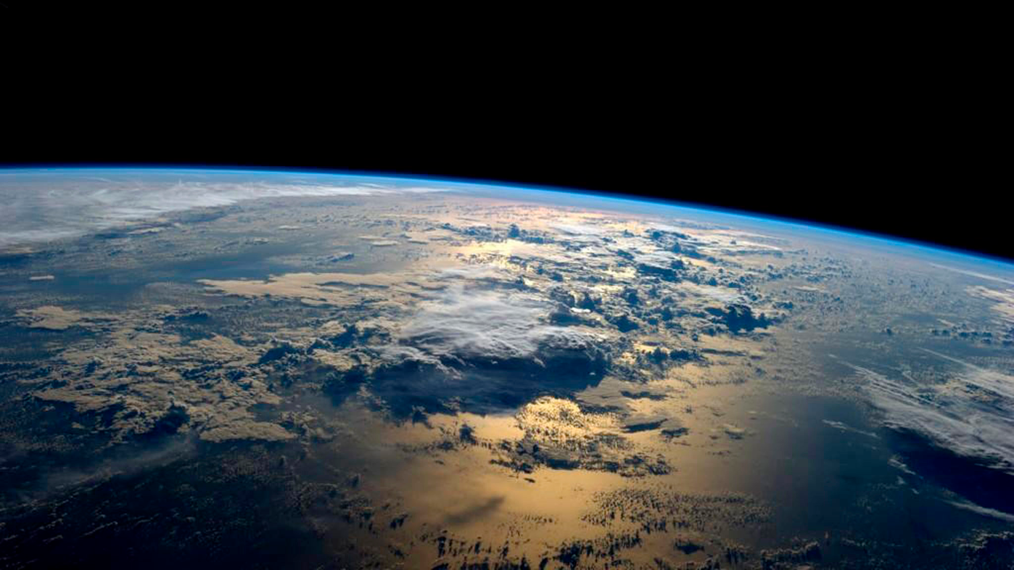
God’s Intervention
Revelation 14:6-7 And I saw another angel flying in mid-heaven, having an eternal gospel to preach to those who live on the earth, and to every nation and tribe and tongue and people; and he said with a loud voice, “Revere God! Give Him glory, because the hour of His judgment has come; worship Him who made the heaven and the earth and sea and springs of waters."
Matthew 24:14 And the Good News about the Kingdom will be preached throughout the whole world, so that all nations will hear it; and then the end will come.
Notes:
“Etern. Gosp” = MATTERS! Only 1x!!
=4 Every Nation → **Mt.24 Taken Global!
“Gosp” = What G Did 4 U! ~U do 4 G!
“Revere” → G=KIND! → Luk @Fall/Beauty/Profound
BUT: He WILL Intervene = “JUDGE”

Slide 12
God’s Intervention
Revelation 14:8 And another angel, a second one, followed, saying, "Fallen, fallen is Babylon the great, she who has made all the nations drink of the wine of the passion of her immorality."
The System’s Origins
1 John 2:16 For all that is in the system, the lust of the flesh and the lust of the eyes and the boastful pride of life, is not from the Father, but is from the world.
The System’s Future
1 John 2:17 The system is passing away, and also its lusts; but the one who does the will of God lives forever.
Genesis 11:6 “…they have all one language… nothing that they propose to do will be impossible for them.”
The System’s Power
Notes:
“Babylon”=W.S. → Anti-K.O.G.
**Gen.11→Pwrfl. EVIL→Destry
Internet→Atom→Indust.Age→Ships
Tribulat=G. Allows Globalization
b/c → **1Jn.2 EVIL/Satanic ** DOOMED

Slide 13
God’s Intervention
Revelation 14:9-11 And another angel, a third, followed them, saying with a loud voice, “If anyone worships the beast and its image and receives a mark on his forehead or on his hand, he also will drink the wine of God’s wrath, poured full strength into the cup of his anger, and he will be tormented with fire and sulfur in the presence of the holy angels and in the presence of the Lamb. And the smoke of their torment goes up forever and ever, and they have no rest, day or night, these worshipers of the beast and its image, and whoever receives the mark of its name.”
Revelation 15:3 And they sing the song of Moses, the servant of God, and the song of the Lamb, saying, “Great and amazing are your deeds, O Lord God the Almighty! Just and true are your ways, O King of the nations! …All nations will come and worship you, for your righteous acts have been revealed.”
Revelation 5:12-13 “Worthy is the Lamb who was slain, to receive power and wealth and wisdom and might and honor and glory and blessing!” And I heard every creature in heaven and on earth and under the earth and in the sea, and all that is in them, saying, “To him who sits on the throne and to the Lamb be blessing and honor and glory and might forever and ever!”
Notes:
“Fire” = Symbolic → 1) Spirits ~Burn 2) “Outr Darkn”
“Torment”=Unfulfilled Lust→Nature of Greed/Lust
“Presence..Lamb” → Governs Hell? =G’s MERCY
**Rev.15:3= “Just..true..RIGHT! …All Agree!” **Rev.5

Slide 14
Armageddon
The Inexorable Event
Revelation 14:20 And the wine press was trodden outside Jerusalem, and blood came out from the wine press, up to the horses' bridles, for a distance of two hundred miles.
Zechariah 14:12 Now this will be the plague with which the LORD will strike all the peoples who have gone to war against Jerusalem; their flesh will rot while they stand on their feet, and their eyes will rot in their sockets, and their tongue will rot in their mouth.
Zechariah 12:2-3 "I am going to make Jerusalem a cup that causes reeling to all the peoples …I will make Jerusalem a heavy stone for all the peoples; all who lift it will be severely injured. And all the nations of the earth will be gathered against it.
Revelation 15:5-8 After these things I looked, and the temple of the tabernacle of testimony in heaven was opened, and the seven angels who had the seven plagues came out of the temple, clothed in linen, clean and bright, and girded around their chests with golden sashes. Then one of the four living creatures gave to the seven angels seven golden bowls full of the wrath of God, who lives forever and ever. And the temple was filled with smoke from the glory of God and from His power; and no one was able to enter the temple until the seven plagues of the seven angels were finished.
A Single GREAT Event
“Wrath” Means “God Allows”
Notes:
** Single→~Interrupt ** “Allows”=Globalization
=Chaos/Destruction/Death Apart From G
**Event=Rev.14 Summary→ **Zech 14 ??In Jerus??
**Zech.12 →INEXORABLE 2DAY

Slide 15
Armageddon – the Details
Revelation 16:1-3 Then I heard a loud voice from the temple, saying to the seven angels, "Go and pour out on the earth the seven bowls of the wrath of God." So the first angel went and poured out his bowl on the earth; and it became a loathsome and malignant sore on the people who had the mark of the beast and who worshiped his image. The second angel poured out his bowl into the sea, and it became blood like that of a dead man; and every living thing in the sea died.

Slide 16
Armageddon – the Details
The End of “Might Makes Right”
Revelation 13:10 If anyone is for captivity, to captivity he goes; if anyone kills with the sword, with the sword he must be killed.
Matthew 26:52-53 Jesus said to him, "Put your sword back into its place; for all those who take up the sword shall perish by the sword.”
Revelation 16:4-7 Then the third angel poured out his bowl into the rivers and the springs of waters; and they became blood. And I heard the angel of the waters saying, "Righteous are You, who are and who were, O Holy One, because You judged these things; for they poured out the blood of saints and prophets, and You have given them blood to drink. They deserve it." And I heard the altar saying, "Yes, O Lord God, the Almighty, true and righteous are Your judgments."
Notes:
G’s Judgement= “Go 4 It! All U Can Drink!”
** Might=Right=Violence=Most Pwrful?
**Rev.13=Tribult=Final Proof→Should’ve Known
**Mt.26=JC’s Arrest/Crucifx→ ~Mk.Sense!?

Slide 17
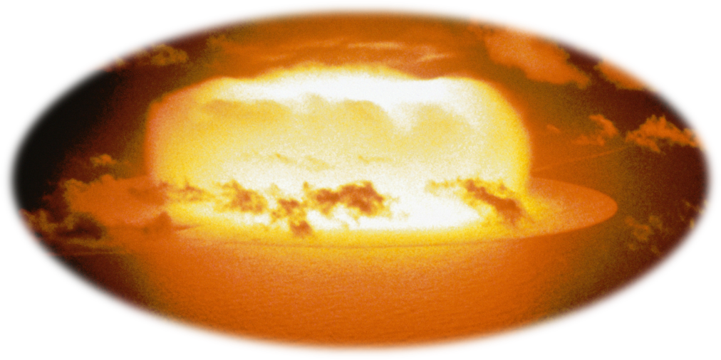
Armageddon – the Details
Revelation 16:8-9 The fourth angel poured out his bowl upon the sun, and it was given to it to scorch men with fire. Men were scorched with fierce heat; and they blasphemed the name of God who has the power over these plagues, and they did not repent so as to give Him glory.
Isaiah 13:6-8 …They will look at one another in astonishment, Their faces aflame.
Notes:
=1st C Man’s TERRIFIED Descript → **NUKES
**=Isaiah→Imagine Seeing Nuclear Age!!
=DIFFICULT 2 Describe!

Slide 18
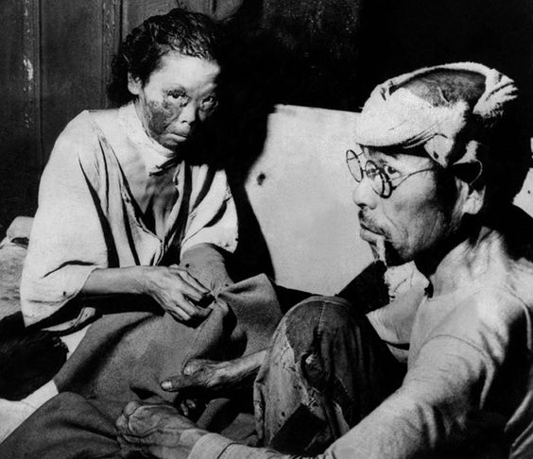
Armageddon – the Details
Revelation 16:10-11 Then the fifth angel poured out his bowl on the throne of the beast, and his kingdom became darkened; and they gnawed their tongues because of pain, and they blasphemed the God of heaven because of their pains and their sores; and they did not repent of their deeds.
Notes:
=Radiation Sickness → **HIROSHIMA
??Blame G?? → G=Allowed It, Yes
Ppl=Oblivious/Self-Willed/Arrogant UNTIL
** Doomsday Clock=CLOSER THAN EVER

Slide 19
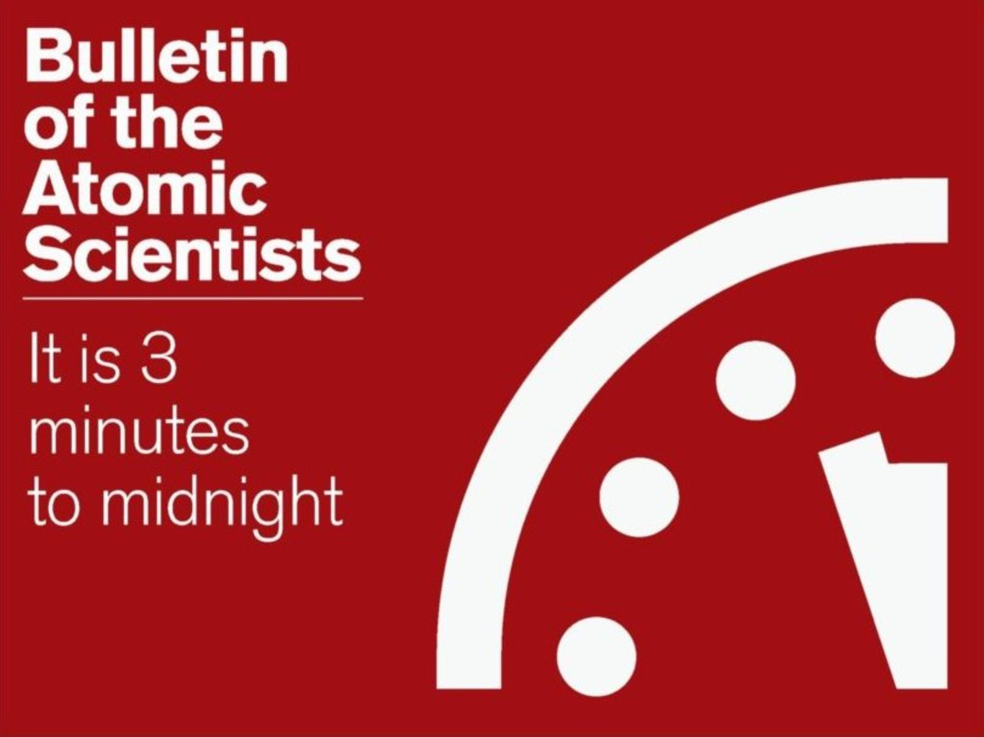
Armageddon – the Details
Notes:
** Doomsday Clock=CLOSER THAN EVER
PROLIFERATION→Korea/Iran/Pakistan/ISIS

Slide 20
Armageddon – the Details
Revelation 16:12-14 The sixth angel poured out his bowl on the great river, the Euphrates; and its water was dried up, so that the way would be prepared for the kings from the east. And I saw coming out of the mouth of the dragon and out of the mouth of the beast and out of the mouth of the false prophet, three unclean spirits like frogs; for they are spirits of demons, performing signs, which go out to the kings of the whole world, to gather them together for the war of the great day of God, the Almighty.
Notes:
“Might=Right” → Demonic Pwr=KILL PPL → w/ SIGNS
Humank=Follows Demonic Leadership→ISLAM?
Leads 2 WAR

Slide 21
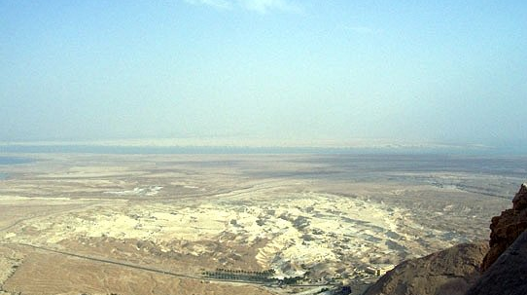
The Inexorable Armageddon
Revelation 16:16 And they gathered them together to the place which in Hebrew is called Har-Magedon.
President Reagan 5/15/81
Sometimes I wonder if we’re destined to witness Armageddon
President Reagan 6/7/81
I swear I believe Armageddon is near.
Napoleon
The nations of the world could maneuver their forces on this vast plane…the most natural battlefield.
Notes:
“Inexorable” b/c World=Hates Israel
** Reagan=Amazed by Mideast ** Bombing Iran Reactor
** Napolean

Slide 22
God’s Intervention: What Matters
Isaiah 33:6 And He will be the stability of your times, A wealth of salvation, wisdom and knowledge; The fear of the LORD is his treasure.
Matthew 24:32 "Now learn the parable from the fig tree: when its branch has already become tender and puts forth its leaves, you know that summer is near; so, you too, when you see all these things, recognize that He is near, right at the door.

Slide 24
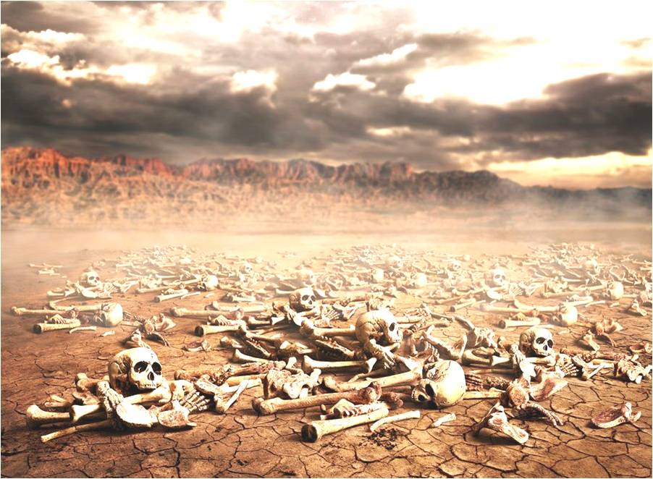
The Course of Humanity
Israel will be dispersed and regathered.
Ezekiel 37:1-8 The LORD took hold of me, and I was carried away by the Spirit of the LORD to a valley filled with bones. He led me all around among the bones that covered the valley floor. They were scattered everywhere across the ground and were completely dried out. Then he asked me, “Son of man, can these bones become living people again?” “O Sovereign LORD,” I replied, “you alone know the answer to that.”
Then he said to me, “Speak a prophetic message to these bones and say, ‘Dry bones, listen to the word of the LORD! This is what the Sovereign LORD says: Look! I am going to put breath into you and make you live again! I will put flesh and muscles on you and cover you with skin. I will put breath into you, and you will come to life. Then you will know that I am the LORD.’” So I spoke this message, just as he told me.

Slide 25
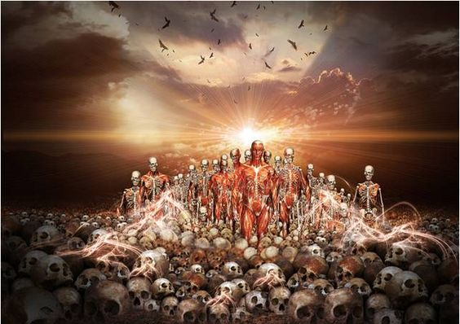
The Course of Humanity
Israel will be dispersed and regathered.
Suddenly as I spoke, there was a rattling noise all across the valley. The bones of each body came together and attached themselves as complete skeletons. Then as I watched, muscles and flesh formed over the bones. Then skin formed to cover their bodies, but they still had no breath in them.

Slide 26
The Course of Humanity
Israel will be dispersed and regathered.
Ezekiel 37:9-10 Then he said to me, “Speak a prophetic message to the winds, son of man. Speak a prophetic message and say, ‘This is what the Sovereign LORD says: Come, O breath, from the four winds! Breathe into these dead bodies so they may live again.’” So I spoke the message as he commanded me, and breath came into their bodies. They all came to life and stood up on their feet—a great army.

